Slide 1
Are magnetic fields and outflows aligned in protostellar cores?
Chat Hull
University of California, Berkeley
Radio Astronomy Laboratory
28 September 2013
Academic Exchange Session: Physical Sciences & Mathematics
2013 Conference of Ford Fellows
Washington, D.C.
Notes:
Star formation regions

Slide 2
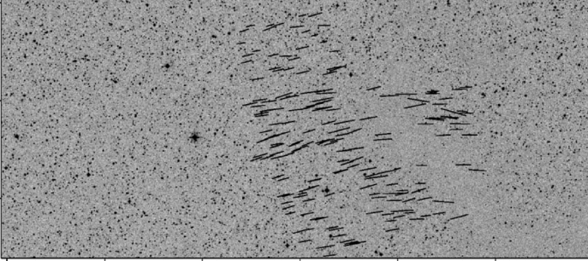
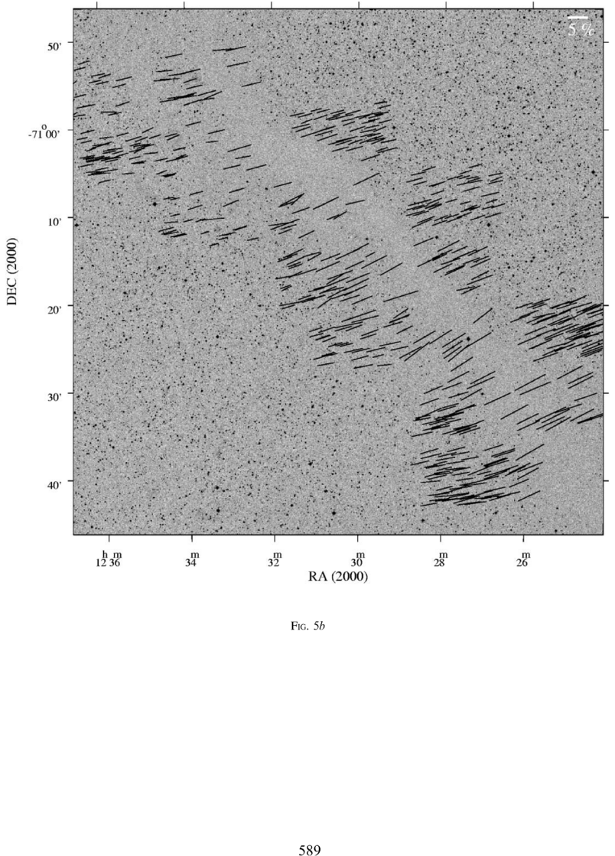
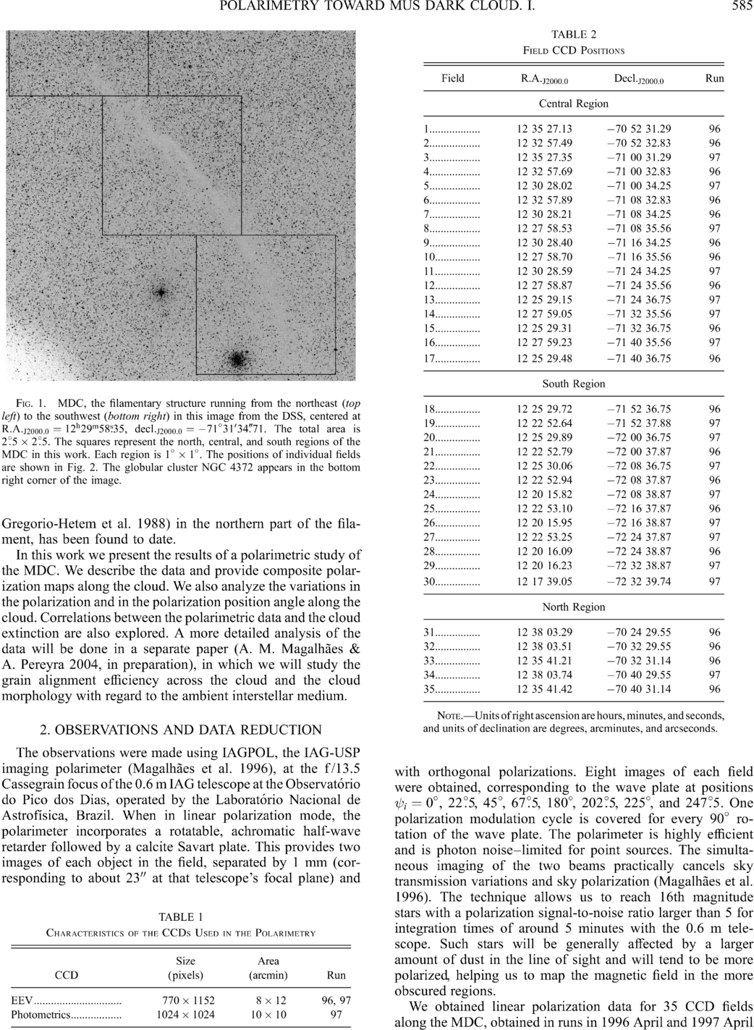
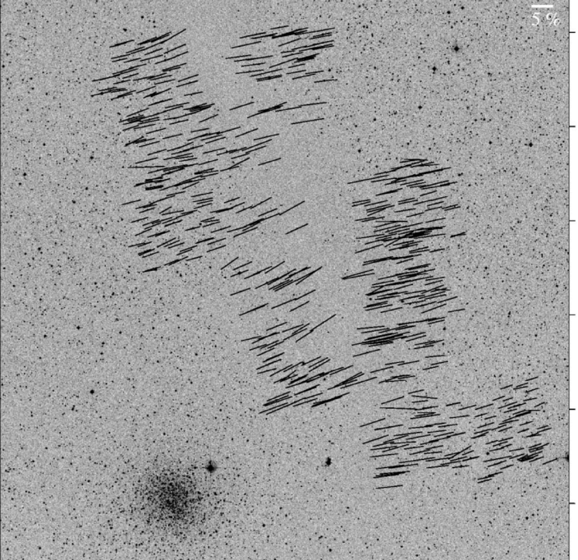
Large-scale: ordered fields
Musca dark cloud
10 pc
E,B
Pereyra & Magalhães 2004
Notes:
-Distance: 250 pc
-Mass: 250 solar masses
-Length ~10 pc

Slide 3


What is the role of magnetic fields in star formation?
Nothing but a smiley face in the froth?
Fundamental?

Slide 4
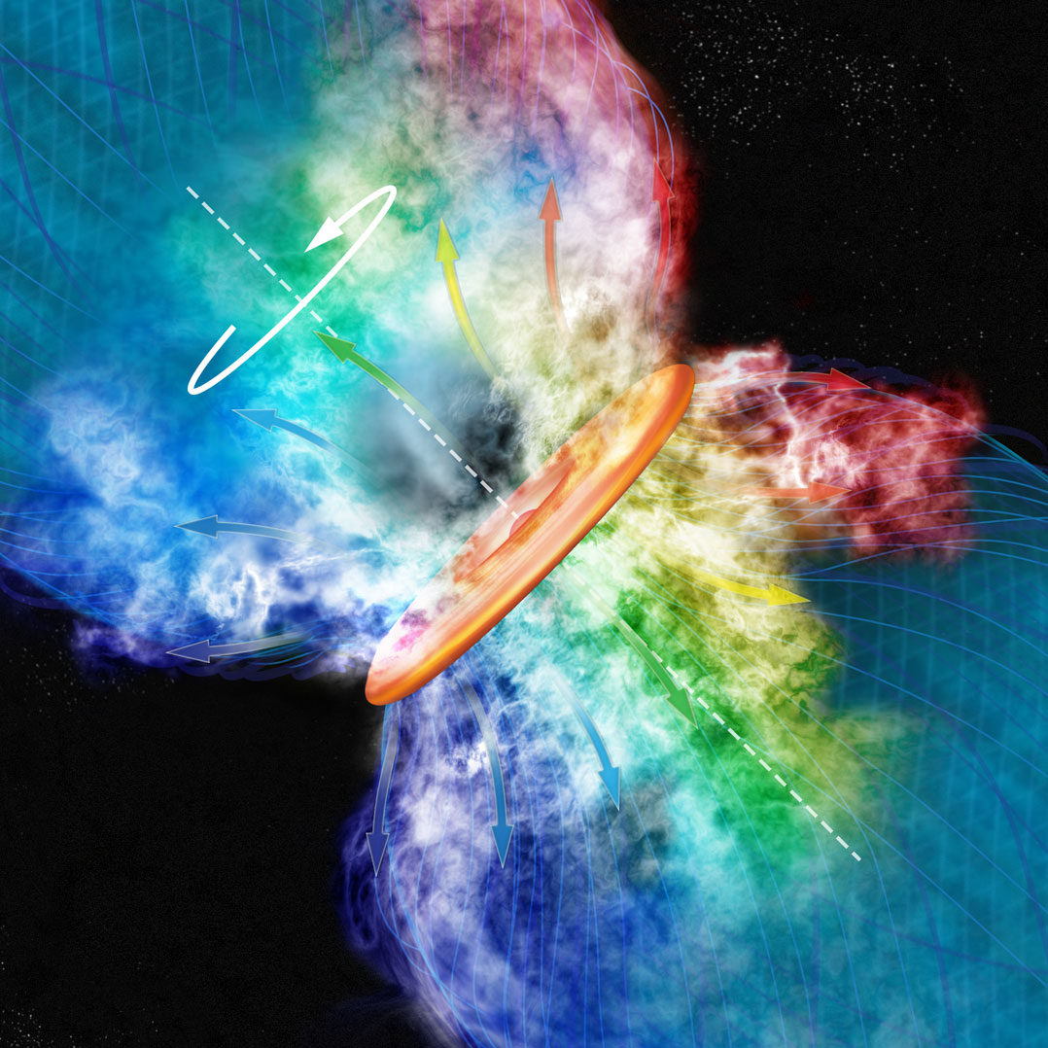
Credit: Bill Saxton, CfA

Slide 5
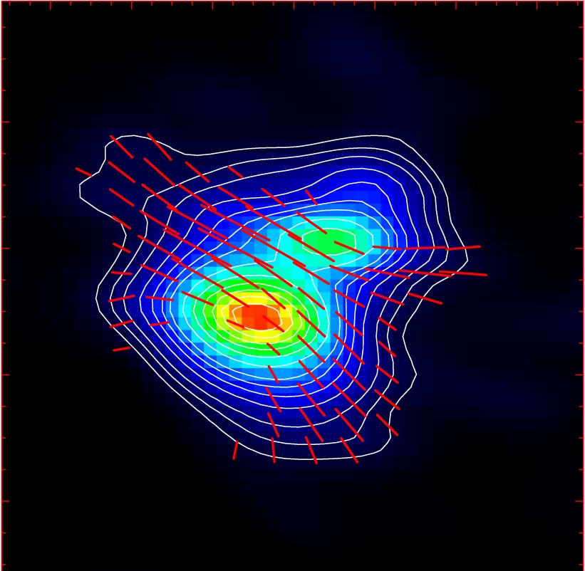
Misalignment of B-fields and outflows
IRAS 16293
NGC 1333-IRAS 4A
B-field
Rao+ 2009
Girart+ 2006
Outflow
Notes:
ROTATION: IRAS 16293 has rot/grav < 0.1; IRAS4A seems the same (barely any rotation); VLA 1623 questionable (probably slow)
-Holland: JCMT data
-Rao, Girart: SMA
-This is okay, according to Hennebelle & Ciardi ‘09 (easier to form disks with obliquity!)
-Ward-Thompson et al (2009) saw a 30 deg offset between short axes of cores and their polarization directions…another problem!

Slide 6
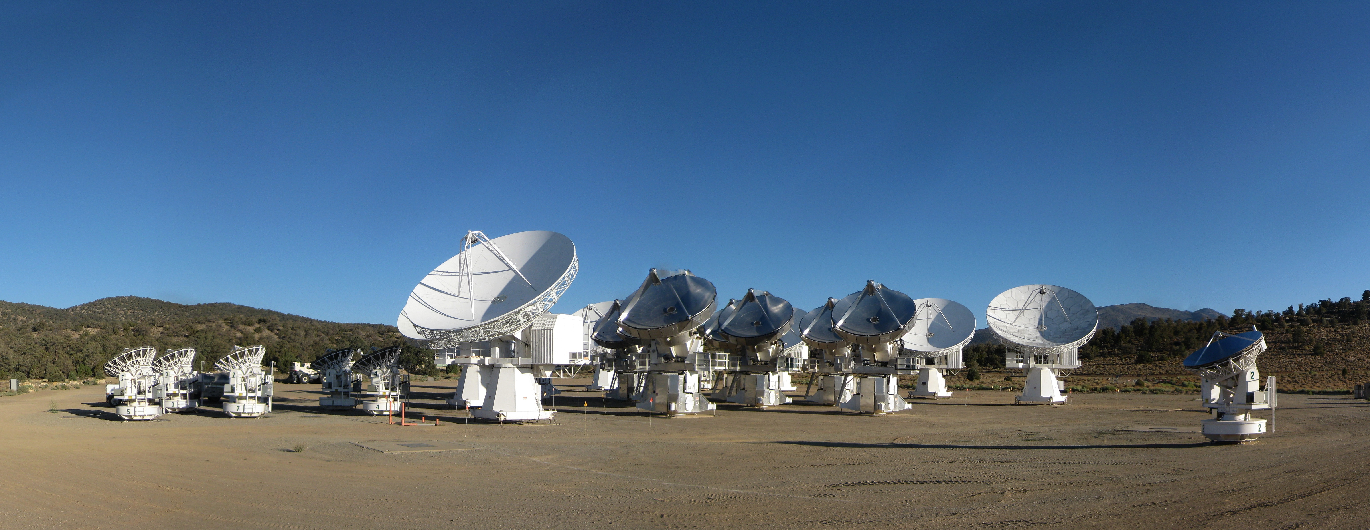
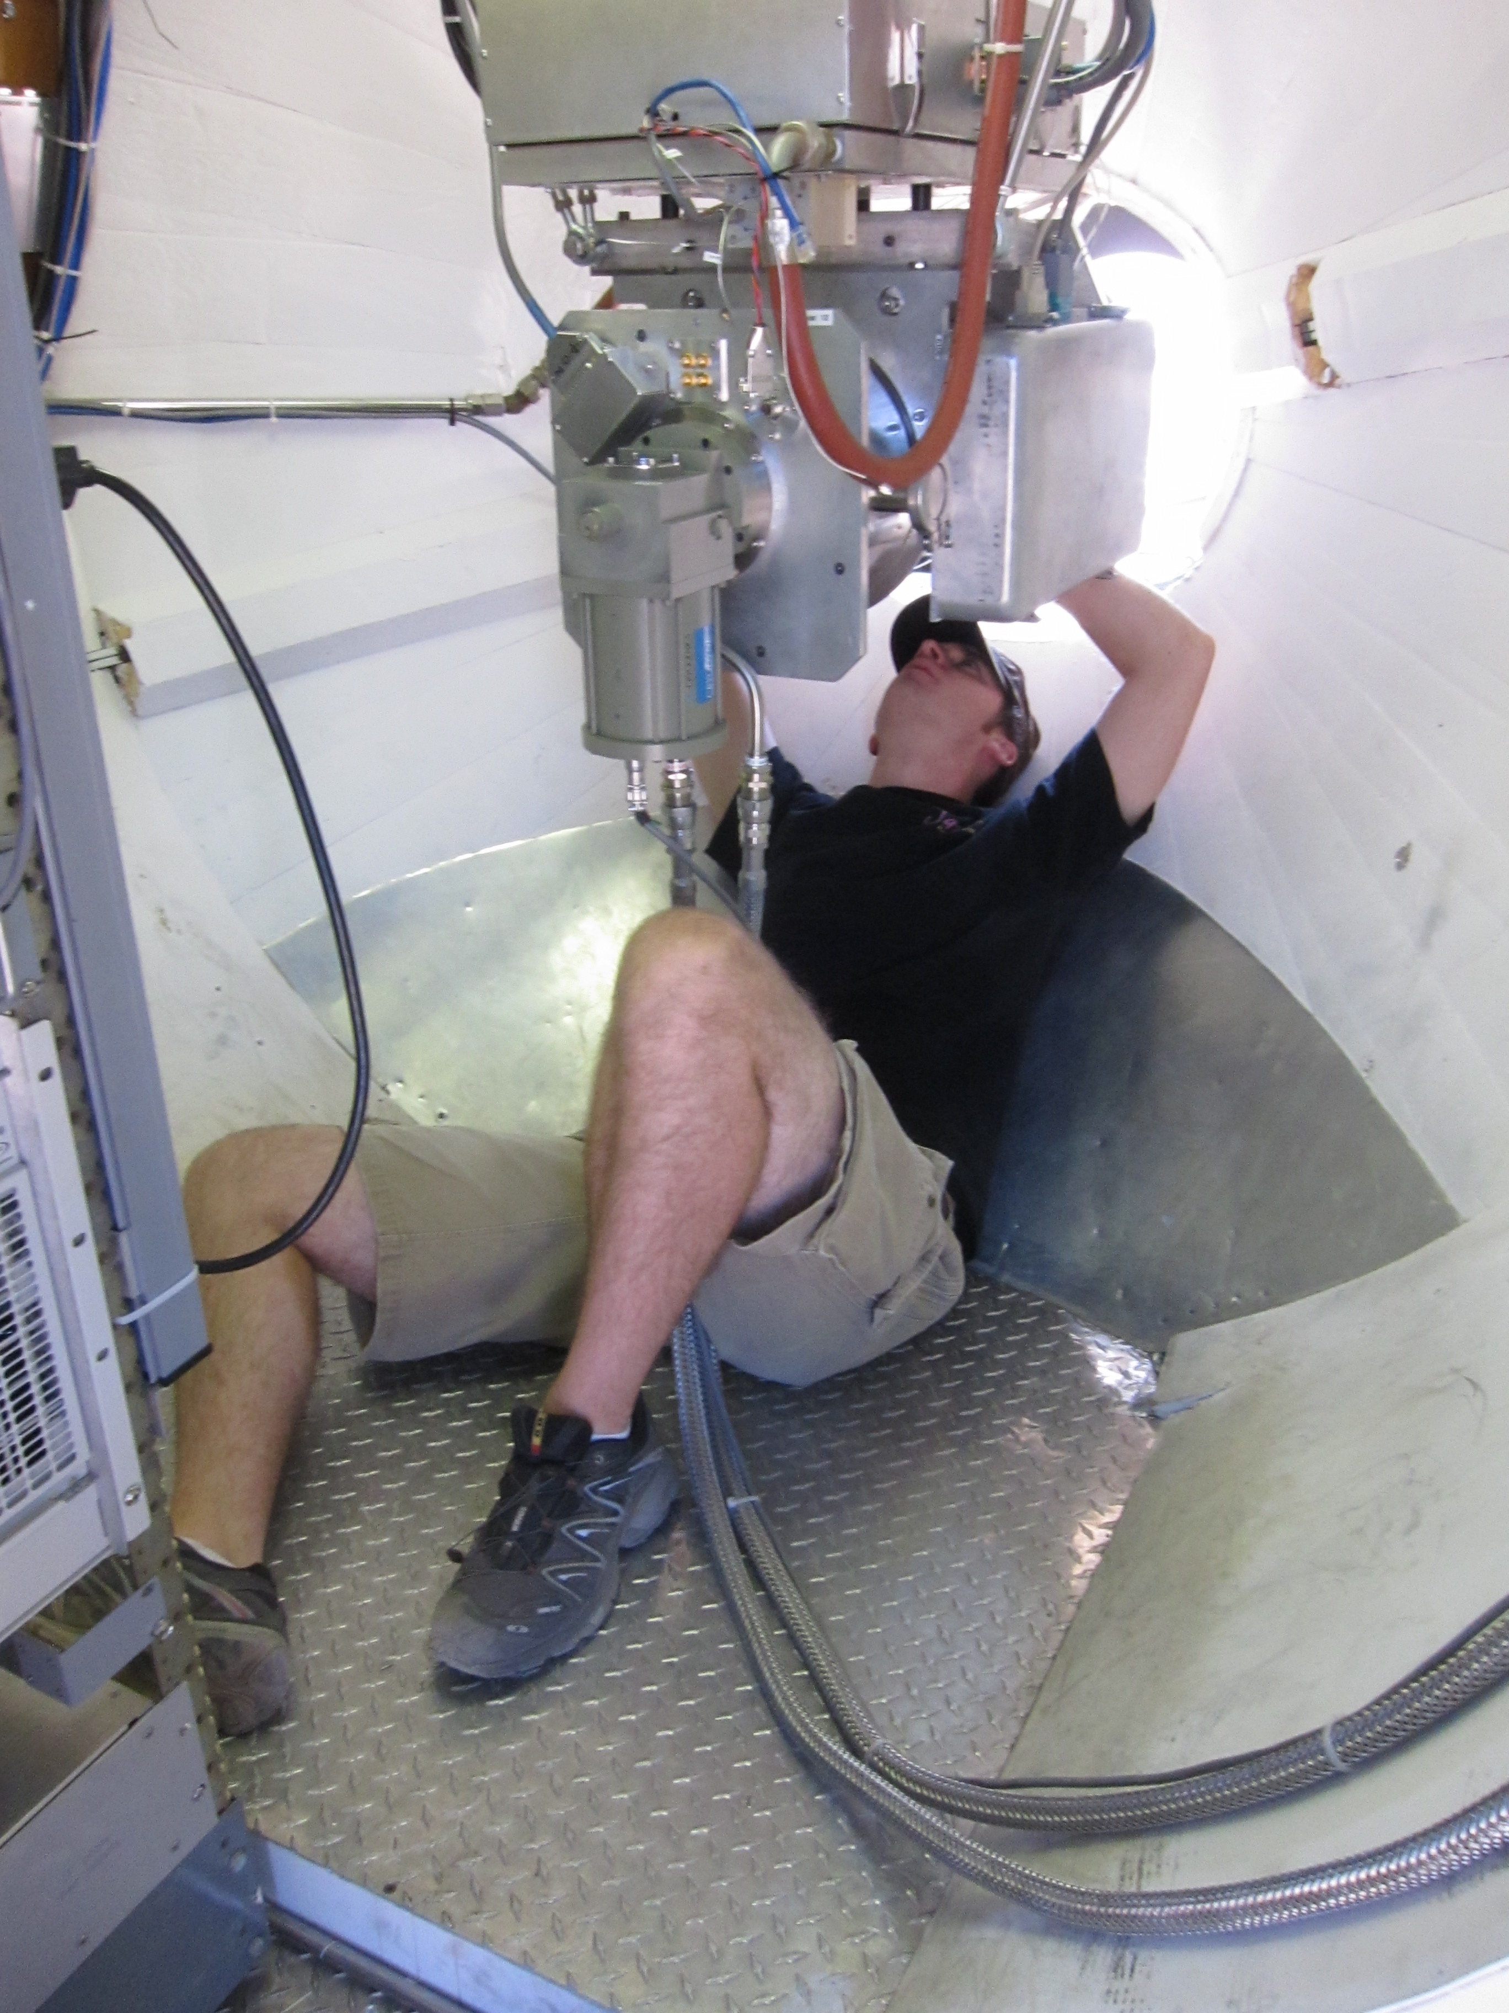
CARMA Combined Array for Research in Millimeter-wave Astronomy Consortium: Berkeley, Caltech, Illinois, Maryland, Chicago
6 ⨯10-m, 9 ⨯ 6-m, 8 ⨯ 3.5-m telescopes
Observations at 1 cm, 3 mm, and 1 mm (polarization!)
Located in Cedar Flat, CA (near Bishop)
Notes:
SMA: 8*6m antennas = 226 m^2
CARMA: 6*10m, 9*6m = 726 m^2 (more than factor of 3 more area)
-Factor of two more dishes
-Equivalent T_sys?

Slide 7
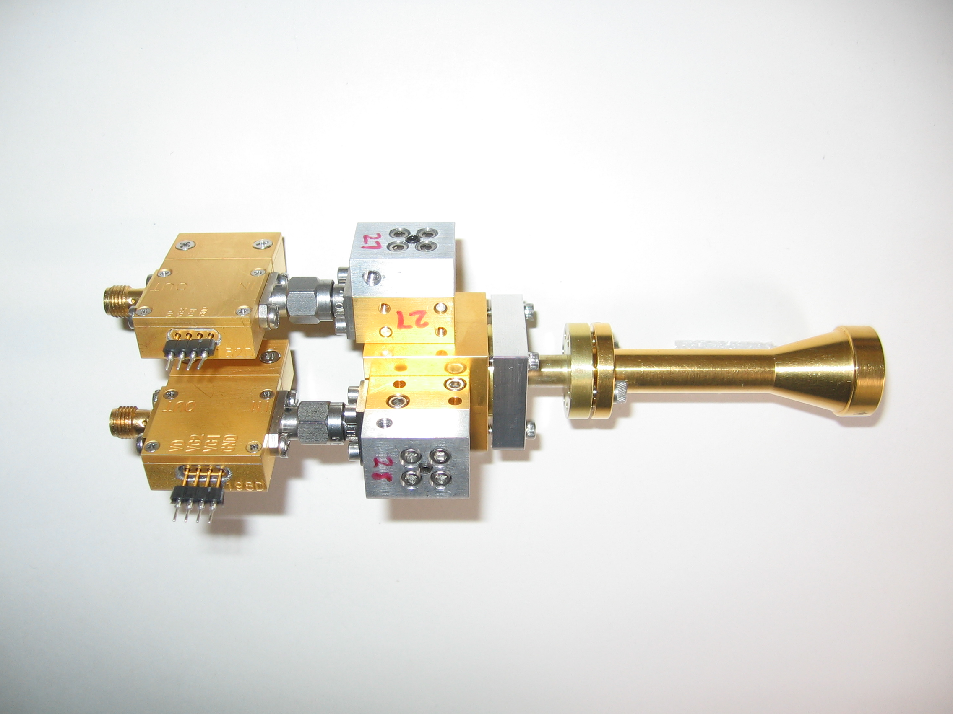
1 mm dual-polarization receivers
SIS mixers
Orthomode transducer
Waveguide circular polarizer
1 inch
WBA13
I.F. amplifiers (1-9 GHz)
Credit: Dick Plambeck
Notes:
-Sensitive to RCP & LCP
-Null experiment: in the absence of linear polarization, you get no RL correlation at any time.
-If you have linear feeds, you have XY correlation sometimes (when the intrinsic polarization is at 45º to your two feeds), and not other times (when it’s along one feed or the other). Thus, to tease out the polarization, you need stable gains

Slide 8
Misalignment of B-fields and outflows
IRAS 16293
NGC 1333-IRAS 4A
B-field
Rao+ 2009
Girart+ 2006
Outflow
Notes:
ROTATION: IRAS 16293 has rot/grav < 0.1; IRAS4A seems the same (barely any rotation); VLA 1623 questionable (probably slow)
-Holland: JCMT data
-Rao, Girart: SMA
-This is okay, according to Hennebelle & Ciardi ‘09 (easier to form disks with obliquity!)
-Ward-Thompson et al (2009) saw a 30 deg offset between short axes of cores and their polarization directions…another problem!

Slide 9
TADPOL survey

Slide 10
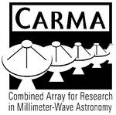














TADPOL collaboration
UC Berkeley
Chat Hull (PI), Dick Plambeck, Mel Wright, Carl Heiles, Geoff Bower
University of Maryland
Marc Pound, Alberto Bolatto, Katherine Jameson,
Lee Mundy
Caltech
Thushara Pillai, John Carpenter, James Lamb,
Nikolaus Volgenau
University of Illinois, Urbana-Champagne
Leslie Looney, Dick Crutcher, Nick Hakobian
Other
Dan Marrone (Arizona), Meredith Hughes (Wesleyan), John Vaillancourt & Göran Sandell (USRA-SOFIA), John Tobin (NRAO), Ian Stephens (BU), Jason Fiege & Erica Franzmann (Manitoba), Martin Houde (UWO, Caltech), Brenda Matthews (NRC-CNRC), Woojin Kwon (SRON)

Slide 11
TADPOL survey
37 sources
Largest survey of star-forming cores to date
>500 observing hours
CARMA C, D, & E arrays
1 – 4" resolution
10⨉ higher resolution than CSO & JCMT
Probes intermediate region between ~0.1 pc (single-dish)
and ~100 AU (ALMA)

Slide 12
TADPOL results
L1157
2″
See also: Stephens+ 2013, ApJL, 769, L15
Notes:
NEARBY SF regions:
-Perseus (NGC 1333, L1448, SVS13): 235 pc (masers in SVS13) → 03:30 LST
-Taurus (DG Tau, L1527): 140 pc → 04:30 LST
-Orion: 400 pc → 05:30 LST
-Serpens: 415 pc → 18:30 LST
-Ophiuchus: 140 pc → 17:00 LST
-Cepheus (L1157): 250 pc → 22:00 LST
-Isolated (B335, Bok globule): 250 pc

Slide 13
Credit: Bill Saxton, CfA

Slide 14
TADPOL results
NGC 1333-IRAS 4A
NGC 1333-IRAS 4B
4B
4B2
2″
2″
Notes:
NEARBY SF regions:
-Perseus (NGC 1333, L1448, SVS13): 235 pc (masers in SVS13) → 03:30 LST
-Taurus (DG Tau, L1527): 140 pc → 04:30 LST
-Orion: 400 pc → 05:30 LST
-Serpens: 415 pc → 18:30 LST
-Ophiuchus: 140 pc → 17:00 LST
-Cepheus (L1157): 250 pc → 22:00 LST
-Isolated (B335, Bok globule): 250 pc

Slide 15
TADPOL results
L1527
NGC 1333-IRAS 2A
2″
3″
Notes:
NEARBY SF regions:
-Perseus (NGC 1333, L1448, SVS13): 235 pc (masers in SVS13) → 03:30 LST
-Taurus (DG Tau, L1527): 140 pc → 04:30 LST
-Orion: 400 pc → 05:30 LST
-Serpens: 415 pc → 18:30 LST
-Ophiuchus: 140 pc → 17:00 LST
-Cepheus (L1157): 250 pc → 22:00 LST
-Isolated (B335, Bok globule): 250 pc

Slide 16
TADPOL results
Ser-emb 8
3″
Notes:
NEARBY SF regions:
-Perseus (NGC 1333, L1448, SVS13): 235 pc (masers in SVS13) → 03:30 LST
-Taurus (DG Tau, L1527): 140 pc → 04:30 LST
-Orion: 400 pc → 05:30 LST
-Serpens: 415 pc → 18:30 LST
-Ophiuchus: 140 pc → 17:00 LST
-Cepheus (L1157): 250 pc → 22:00 LST
-Isolated (B335, Bok globule): 250 pc

Slide 17
Outflow vs. B-field: distribution
Simulation: outflows & B-fields aligned within a 20º cone (tightly aligned)
Simulation: outflows & B-fields are randomly oriented
CDF
Simulation: outflows & B-fields aligned between 70–90º (preferentially misaligned)
KS-test results:
20º cone ruled out ( p-value ~ 10⁻¹⁵ )
Misaligned ( 0.33 ) and random ( 0.33 ) cannot be ruled out
Hull+ 2013a, ApJ, 768, 159
(plot updated Aug ‘13)
𝜽_{outflow} – 𝜽_{B-field} (deg)

Slide 18
Summary
B-fields are either preferentially misaligned (perp.) or randomly aligned with respect to outflows at the ~1000 AU scale
Thus, circumstellar disks are misaligned with fields in the cores from which they formed
Questions:
Why are B-fields and outflows randomly aligned?
What will disk-scale B-field measurements show?
TADPOL outflows vs. B-fields: ApJ, 768, 159
TADPOL survey (CARMA key project): tadpol.astro.illinois.edu
Notes:
Other TADPOL future possibilities:
Intrinsic modeling of B-fields in cores (Fiege)
Constraints on B-fields in protoplanetary disks (Hughes)
Turbulence power spectra (Houde)
Larger scale background-star maps (Mimir, Jameson/Pillai/Clemens)

Slide 19
Fin

